Slide 1
jQuery - Introduction
Write Less Do More

Slide 2
Agenda
Developing with JavaScript & HTML
Issues with HTML
About jQuery
Author
Introduction
What jQuery do ?
5 Things jQuery Provides
The DOM
Main DOM Objects
Features
Advantages
Deployment
Tools & Inspectors
Usage Trend
Release History
Developer resources

Slide 3
Developing with JavaScript
JavaScript become essential for modern web page development, but ….
JavaScript has become bloated
DOM Navigations
Browser differences
Writing JavaScript code is
Tedious
Time consuming
Error prone

Slide 4


Is your HTML cluttered?

Slide 5
jQuery to the rescue
jQuery makes writing JavaScript easier
DOM Navigation
Apply methods to set of DOM objects
Builder models
Extensible and tons of libraries
Cross Browser support
Easy and advanced UI components
Lightweight

Slide 6

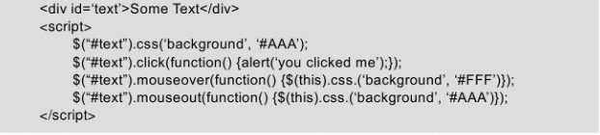
jQuery helps organize the mess

Slide 7
About jQuery
Developed by John Resig at Rochester Institute of Technology
“jQuery is free, open source software Dual-licensed under the MIT License and the GNU General Public License.”
It’s all about simplicity.
Released on 01/06
Current version is 1.5.x

Slide 8
About Author
John Resig
A JavaScript Tool Developer for the Mozilla Corporation and the author of the book Pro JavaScript Techniques.
Also the creator and lead developer of the jQuery JavaScript library.
Microsoft and Nokia have announced plans to bundle jQuery on their platforms.

Slide 9
Introduction
Why do I want it
Rich Internet Applications (RIA)
Dynamic HTML (DHTML)
How do I get it
www.jquery.com
How can I learn it
jQuery in Action by Bibeault & Katz, Manning
www.jquery.com
docs.jquery.com
www.Jqueryfordesigners.com
www.gscottolson.com/weblog/ - cheat sheet
www.javascripttoolbox.com/jquery

Slide 10
Introduction continues…
jQuery is a fast and concise JavaScript Library that simplifies
HTML document traversing
Event handling
Animation
AJAX Interaction for rapid web development.
Designed to change the way that you write JavaScript

Slide 11
What jQuery do ?
“Unobtrusive” JavaScript – separation of behavior from structure
CSS – separation of style from structure
Allows adding JavaScript to your web pages
Advantages over just JavaScript
Much easier to use
Eliminates cross-browser problems
HTML to CSS to DHTML

Slide 12
5 Things jQuery Provides
Select DOM (Document Object Model) elements on a page.
Set properties of DOM elements, in groups
Creates, deletes, shows, hides DOM elements
Defines event behavior on a page
AJAX Calls
Notes:
Select DOM (Document Object Model) elements on a page – one element or a group of them
Set properties of DOM elements, in groups (“Find something, do something with it”)
Creates, deletes, shows, hides DOM elements
Defines event behavior on a page (click, mouse movement, dynamic styles, animations, dynamic content)
AJAX calls

Slide 13
The DOM
Document Object Model
jQuery is “DOM Scripting”.
Hierarchal structure of a web page
You can add and subtract DOM elements on the fly
You can change the properties and contents of DOM elements on the fly
Notes:
Document Object Model
jQuery is “DOM scripting”
Hierarchal structure of a web page
You can add and subtract DOM elements on the fly
You can change the properties and contents of DOM elements on the fly

Slide 14
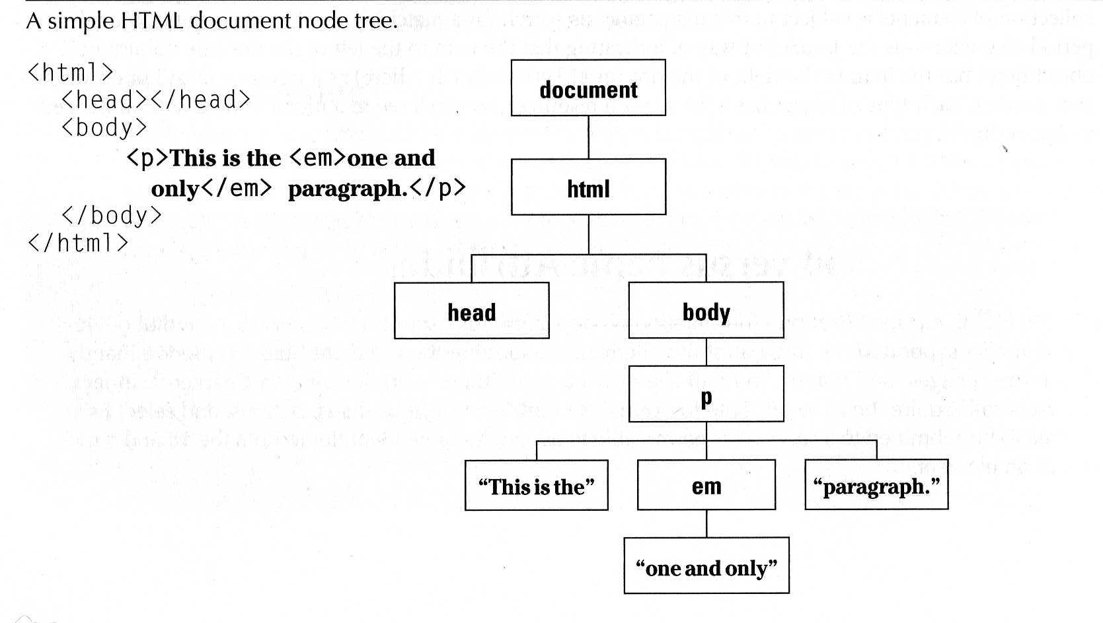
The DOM Continues …
Notes:
“The Document Object Model (DOM) is a cross-platform and language-independent convention for representing and interacting with objects in HTML, XHTML and XML documents. Aspects of the DOM (such as its "Elements") may be addressed and manipulated within the syntax of the programming language in use.” Wikipedia

Slide 15
The DOM Continues
To access the DOM tree, in JavaScript we will do the following.
document.getElementById(<<id of the component>>);
document.getElementsByTagName(p)[index of paragraph]
window.document.childNodes[0].childNodes[1].childNodes[4]

Slide 16
Main DOM Objects
Window
Main properties and methods
Alert()
Close()
Document
Location
Open()
Print()
resizeTo()
scrollTo()
innerWidth, innerHeight

Slide 17
Main DOM objects
Document
Main properties and methods.
getElementById(id)
getElementsByName(name)
getElementsByTagName(tagName)
Forms
Images

Slide 18
Main DOM objects
Element
var imgObj = document.getElementById(img1);
Main Properties and methods
Attributes[]
Childnodes[]
className
innerHTML

Slide 19
Features
Dom Element Selectors
The jQuery Object, Wrapped Set
Wrapped Set operations
Simplified Event Handling
Small footprint
Easy Plug-in Extensibility
Browser Compatibility
Notes:
Key features of jQuery
Let's take a look of why jQuery is a tool worth checking out. There's quite a bit of functionality provided in jQuery but here’s is a list of what I think are the key features:
DOM Element Selectors jQuery Selectors allow you to select DOM elements so that you can apply functionality to them with jQuery’s operational methods. jQuery uses a CSS 3.0 syntax (plus some extensions) to select single or multiple elements in a document. Using CSS means that you use selector syntax you’re probably already familiar with from HTML styling and even if not it’s fairly easy to pick up the key CSS selector features. I’ll go as far as saying that jQuery is the reason I really started to grok CSS. Using CSS syntax you can select elements by id, CSS class, attribute filters, by relationship to other element and even filter conditions that can be chained together. A simple example: It's trivial to select all 2nd column TD elements in a table with a simple selector like this: $("#gdEntries td:nth-child(2)").
The jQuery Object: The Wrapped Set Selectors result in a jQuery object that is known as the Wrapped Set, which is an array like structure that contains each of the selected DOM elements. You can iterate over the wrapped set like an array or access individual elements via the indexer ( $(sel)[0] for example). More importantly though you can also apply jQuery functions against all the selected elements.
Wrapped Set Operations The real power of the wrapped set comes from being able to apply jQuery operations against all selected DOM elements simultaneously. The jQuery.fn object exposes about 100 functions that can operate on the matched set and allow to manipulate and retrieve information from the selected DOM objects in batch. For example, you can easily manipulate all alternate rows in a table by adding a CSS class with $("#gdEntries tr:odd").addClass("gridalternate"). The .addClass() function is applied against each of the matched elements with one command. Intuitive methods allow you do to things like get and set .css() styles directly including smart logic that accounts for browser differences of assignment types (number and string translations mostly) and values (opacity does the right thing on all browsers). You can set and retrieve attributes with .attr(), or retrieve or set a value with .val(), .text() or .html(). You can clone selected DOM elements or create new elements from HTML text used as a selector and inject them into the document with methods like .appendTo(), .prependTo() or reversely use a parent element to .append() or .prepend() the new or selected element(s). There are basic but useful effects methods that can be applied to .show() and .hide() elements in a smart way that checks for opacity, display and visibility and adjusts all to show or hide elements. All of this and much more can be done against all of the selected elements. Most wrapped set operations are also chainable so that they return the jQuery wrapped set object as a result. This means you can chain together many methods in a single command. Effectively this means you can select once, and operate many times against the same object and even filter or expand the wrapped set with methods like .find(), .filter() or .add(). The beauty of many of these functions is that they do things you actually want to do, and they are intuitively overloaded. Methods like .val() or .text() act both as retrieval and setter methods. Methods that deal with numeric values can take either text or numeric values. CSS assignments to browser dependent tags are automatically fixed up. Although the number of functions provided by jQuery is relatively small, many of the functions provide overloaded functionality to perform intuitive behaviors. The end result is that you have a relatively small API to learn, but a much broader range of functionality that is available on it.
Simplified Event Handling Much of what is done in JavaScript code from DOM manipulation to AJAX calls are handled asynchronously and unfortunately the DOM implementations for event handling vary considerably between browsers. jQuery provides an easy mechanism for binding and unbinding events and providing a normalized event model for all supported browsers that makes it very easy to handle events and hook result handlers. All events are called in the context of the element that caused the event and they receive a fixed up and browser normalized event object that is consistent.
Small Footprint jQuery is a fairly compact base library yet it’s feature packed with stuff you'll actually use. In my relatively short time of jQuery use I've gone through well over 85% of the jQuery functions with my code, which points at how useful the library is. All this functionality ends up in a compressed size of just around 16k (94k uncompressed with comments). For that you get selectors, a whole slew of operations that can be performed on the wrapped set, DOM normalization for most browsers, Ajax functionality, a host of utility functions for object/array manipulation and a number of basic effect functionality. Given the high utilization of jQuery in my use this 16k of script download provides a tremendous amount of “Bang for the Buck”.
Easy Plug-in Extensibility jQuery is a language and DOM extension library and it provides a core set of useful features. It's small and tightly focused on providing core functionality and no more. For everything else jQuery provides a very easy plug-in API that has spawned hundreds of plug-ins for almost every conceivable common operation you might think up to perform on a set of DOM elements.
jQuery’s API allows extending the core jQuery object’s operations simply by creating a function and passing the jQuery Wrapped set as a parmeter. In this way plug-ins receive the wrapped set and can operate on it and participate in the jQuery chaining. This very simple but powerful plug-in model is very easy to work with and likely the key of why so many plug-ins exist and jQuery has become so popular so quickly. If you need some specialty functionality, chances are that a plug-in already exists with the functionality you're looking for. And if it doesn't, it's easy enough to creating it yourself with the help of jQuery or another plug-in as a baseline.

Slide 20
Advantages
jQuery is compliant to the following
Internet Explorer 6.0 +
Firefox 2.0 +
Safari 3.0 +
Opera 9.0 +
Google Chrome
Supports CSS 1-3 selectors and more
Lightweight footprint - About 29KB in size
Notes:
Lightweight footprint - About 29KB in size (Minified and Gzipped)

Slide 21
Deployment
Compress jQuery-1.x.x.js
or
Use Google to host jQuery http://code.google.com/apis/ajax/documentation/
Use the remotely hosted jQuery
http://code.jquery.com/jquery-1.x.x.js

Slide 22
Tools & Inspectors
Firebug
Internet Explorer Developer toolbar
Script Debugger in Internet Explorer

Slide 23
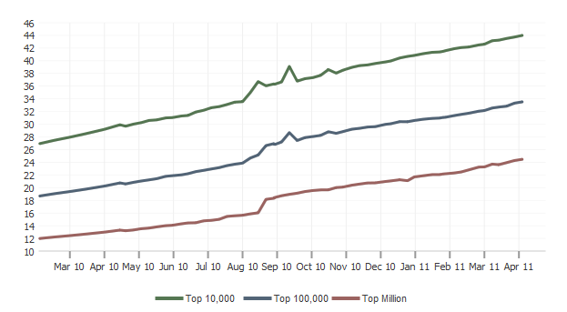
Usage Trend
44% of all sites that use JavaScript use jQuery.
http://trends.builtwith.com/javascript/JQuery

Slide 24
Release History
Release date | Version number | Additional notes
August 26, 2006 | 1.0 | First Stable Release
August 31, 2006 | 1.0.1
October 9, 2006 | 1.0.2
October 27, 2006 | 1.0.3
December 12, 2006 | 1.0.4 | Last 1.0 bug fix
January 14, 2007 | 1.1
January 22, 2007 | 1.1.1
February 27, 2007 | 1.1.2
July 1, 2007 | 1.1.3
July 5, 2007 | 1.1.3.1
August 24, 2007 | 1.1.4
September 10, 2007 | 1.2
September 16, 2007 | 1.2.1

Slide 25
Release History
January 15, 2008 | 1.2.2
February 8, 2008 | 1.2.3
May 19, 2008 | 1.2.4
May 21, 2008 | 1.2.5 | Fix for bad build of 1.2.4
May 24, 2008 | 1.2.6
January 14, 2009 | 1.3 | Sizzle Selector Engine introduced into core
January 21, 2009 | 1.3.1
February 20, 2009 | 1.3.2
January 14, 2010 | 1.4
January 25, 2010 | 1.4.1
February 19, 2010 | 1.4.2
October 16, 2010 | 1.4.3
November 11, 2010 | 1.4.4
January 31, 2011 | 1.5 | Deferred callback management
February 24, 2011 | 1.5.1
March 31, 2011 | 1.5.2

Slide 26
Developer Resources
Official site
http://jquery.com/
Documentation
http://docs.jquery.com/Main_Page
Official Forums
http://forum.jquery.com/
Source Code
http://docs.jquery.com/Downloading_jQuery
Plug-in / Authoring
http://docs.jquery.com/Plugins/Authoring
Raising new Bugs
http://bugs.jquery.com/newticket

Slide 27



References
jQuery in Action
jQuery Enlightment
Learning jQuery 1.3
Introduction to jQuery
http://www.west-wind.com/presentations/jQuery/default.aspx

Slide 28
Q & A

